Slide 1
Mobile Interface Design
Daniel Bauman

Slide 2
On the agenda:
What is Mobile Interface Design
Why it’s important
Challenges in mobile interface design
Design principles
Rules to follow
Helpful tips

Slide 3
What is Mobile Interface Design
Small displays
Typically touch-screen
Diverse environments
High device variability

Slide 4
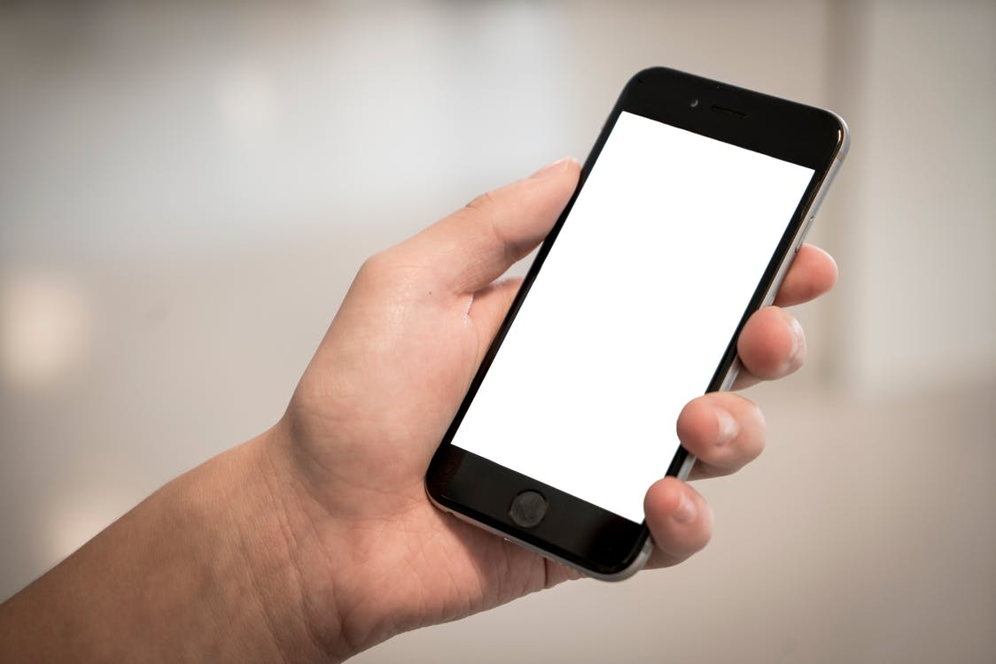


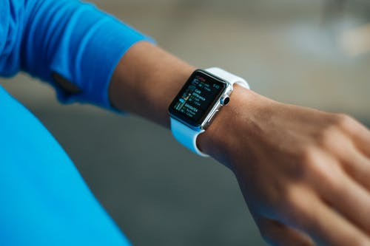
What is Mobile Interface Design
Small displays

Slide 5

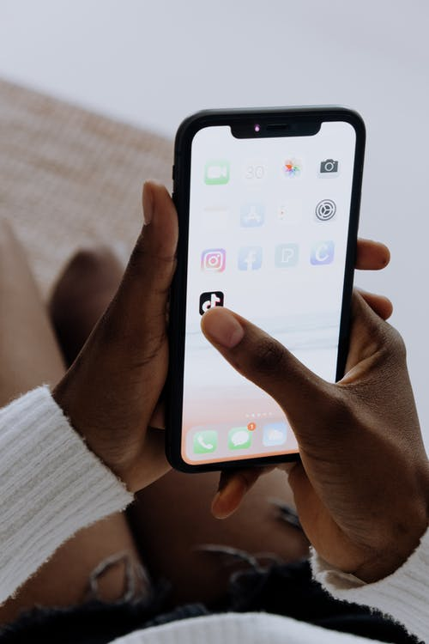

What is Mobile Interface Design
Typically touch-screen

Slide 6




What is Mobile Interface Design
Diverse environments

Slide 7
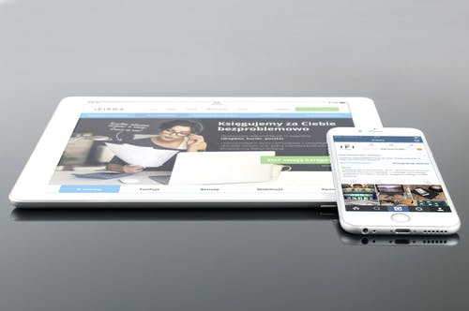
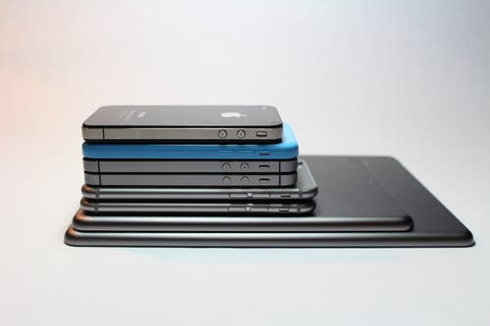
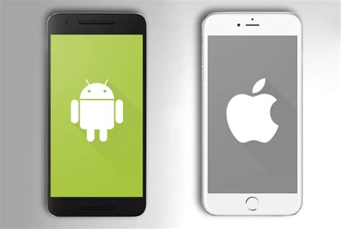
What is Mobile Interface Design
High device variability

Slide 8
Why It’s Important
Apps are more usable
Users can achieve more
Users more likely to continually use app
Users more likely to recommend apps

Slide 9
Why It’s Important
Apps are more usable
Users can use apps uninterrupted
Less frustration
More fun to play with

Slide 10
Why It’s Important
Users can achieve more
Ease of use => Efficiency and time saving
Simple interface => Quicker learning
Mastering functionality => Productivity

Slide 11
Why It’s Important
Users more likely to continually use app
More comfortable experience
Less effort required
Playful interface => easier to spend time on app

Slide 12
Why It’s Important
Users more likely to recommend apps
Fun experience
Useful tool
Novelty

Slide 13
Challenges of Mobile Interface Design
Distracting environments
Small touchscreens
Limited attention

Slide 14



Challenges of Mobile Interface Design
Distracting environments

Slide 15
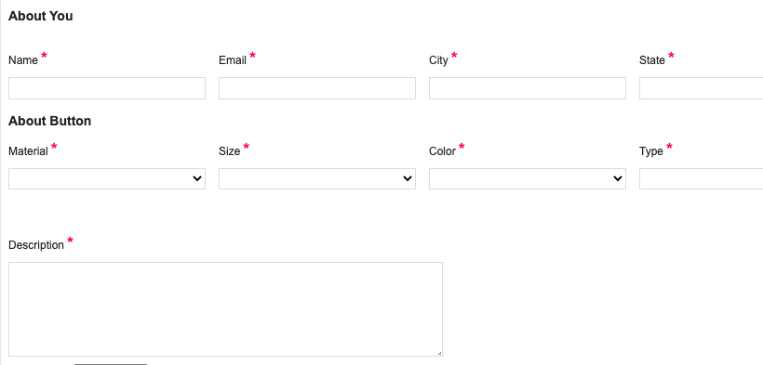

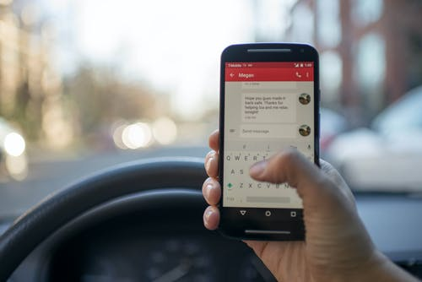
Challenges of Mobile Interface Design
Small touchscreens

Slide 16
Challenges of Mobile Interface Design
Limited attention
Users often in rush
Mobile devices used while multitasking
Mobile devices used for short lengths of time

Slide 17
Design Principles
Personalization
Predictability
Efficiency
Feedback
Aesthetic

Slide 18
Design Principles
Personalization
Allow users to adjust app to their needs / desires
Different users use app differently
Mobile devices typically not shared

Slide 19
Design Principles
Predictability
Allows quick reflexive usage
Little thought needed for experienced users
Less frustration when knowing what to expect

Slide 20
Design Principles
Efficiency
Allows for quick usage when in rush
Little effort needed when functions are a click away
Experienced users enjoy a better experience

Slide 21
Design Principles
Feedback
Ease of use in distracting environments
Easy to catch missed clicks and mistakes
More confidence in success of actions

Slide 22
Design Principles
Aesthetic
Attractive apps are more appealing to use
Users spend more time on app
More likely to be impressed with and recommend app

Slide 23
Rules To Follow
Empty space, buffer
Easy error correction
Large fonts and little text
Use images, media, and animations
Accessibility of functions

Slide 24
Rules To Follow
Empty space, buffer
Small screens + no buffer => mistakes
Easier to read when spaced out
App is more aesthetically pleasing

Slide 25
Rules To Follow
Easy error correction
Errors are more likely in mobile devices
Need to account for this
Allow quick fixing and error prevention
Ex: “Are you sure?” prompt, “undo” option

Slide 26
Rules To Follow
Large fonts and little text
Small screens
Difficult environments (bright sunlight)
Users in a rush

Slide 27
Rules To Follow
Use images, media, and animations
Easier to comprehend
Users need less effort
More likely to keep using app
Animations add novelty

Slide 28
Rules To Follow
Accessibility of functions
Users in a rush
Make everything a click away
Experienced users can use app while multitasking

Slide 29
Helpful Tips
Try using design in progress
Try using all functions
Think of rare scenarios
Make use of unique inputs
Let others try using the design

Slide 30
Helpful Tips
Try using design in progress
Catch mistakes and difficulties early
Adjust design as you work on it
Try on real mobile device

Slide 31
Helpful Tips
Try using all functions
You might miss a difficulty in a function
Your users will NOT miss it
Be thorough

Slide 32
Helpful Tips
Think of rare scenarios
Users will interact with app in many complex situations
A difficulty can arise in a rare situation
Try in different environments

Slide 33
Helpful Tips
Make use of unique inputs
Advantage of mobile devices
Can help avoid issues of small screens and difficult environments
Ex: sound, tilt, gestures, etc.

Slide 34
Helpful Tips
Let others try using the design
You might miss a flaw in design
You may not be thinking of a certain use scenario
Others can give novel perspectives

Slide 35
Summary
What to remember:
Screens are small – space out buttons
Phones used in daylight and bedside – consider brightness
People have a short attention span – make everything a click away

Slide 36
References
Gong, Jun; et al (2004) Guidelines for handheld mobile device interface design.
Santoso, Harry B; et al (2019) Development of Mobile Self-Monitoring Tool Prototype Based on User-Centered Design.
Sang, J.; et al (2013) Interaction Design for Mobile Visual Search.
Ko, SangMin; et al (2013) Usability Principles for Augmented Reality Applications in a Smartphone Environment.
Schneider, Bertrand; et al (2016) Using mobile eye-trackers to unpack the perceptual benefits of a tangible user interface for collaborative learning.
Park, Wonkyu; et al (2011) A factor combination approach to developing style guides for mobile phone user interface.

